Slide 1
Stress

Slide 2
Agenda
Exam Results
Important Terminology
Acute vs. Chronic Stress
Stress Response
Physiology of Stress
Impacts of Chronic Stress
Stressors
Workplace Stress
Stress Adaptation
Studying Stress

Slide 3
Important Terminology
Acute stress – a short-term exposure to stress that can be intense
Chronic stress – a long-term form of stress characterized by substantial physical and psychological strain
Fight-or-flight response – the instinctual and instantaneous response to escape a stressor
Reactivity – the degree of change that occurs in autonomic, endocrine, and/or immune responses as a result of stress
Allostatic load – the cumulative physiological and psychological cost of long-term chronic stress exposure
Hypothalamic-Pituitary-Adrenal (HPA) axis – endocrine system that regulates stress response
Cortisol – the “stress hormone”
Notes:
Homeostasis on one end and allostasis on the other

Slide 4

Acute Stress vs. Chronic Stress
How are they similar?
How are they different?
How do they effect the body differently?
How do we study them?
Notes:
Note: This would be a good topic to make into a venn diagram or t-chart for study material
-acute can actually be a good thing

Slide 5
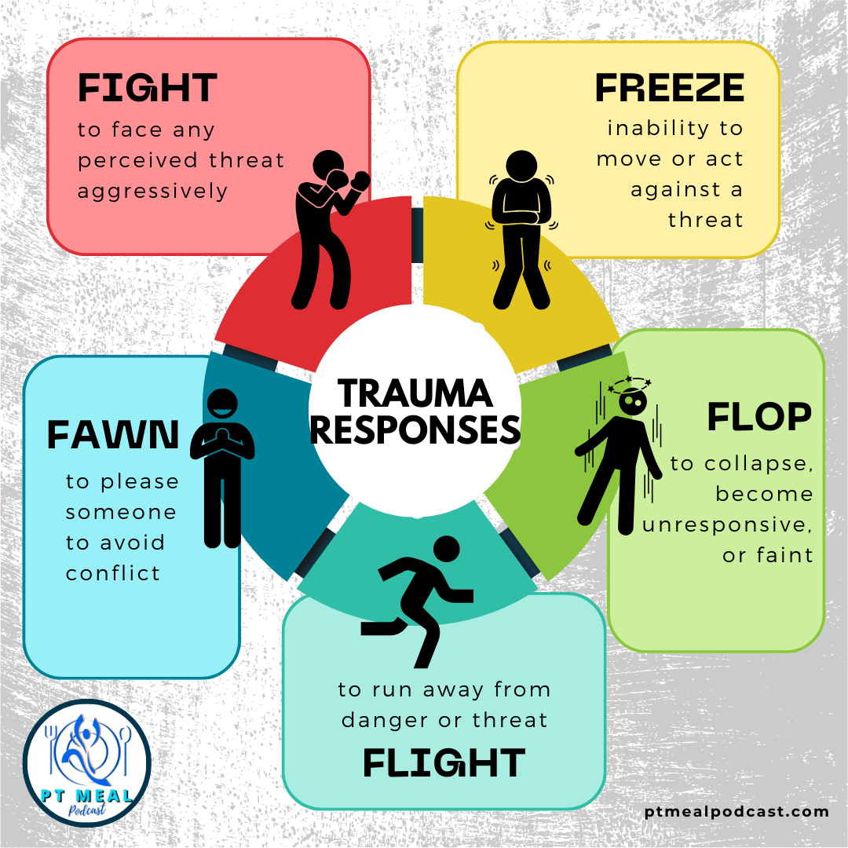
Responding to Stress

Slide 6
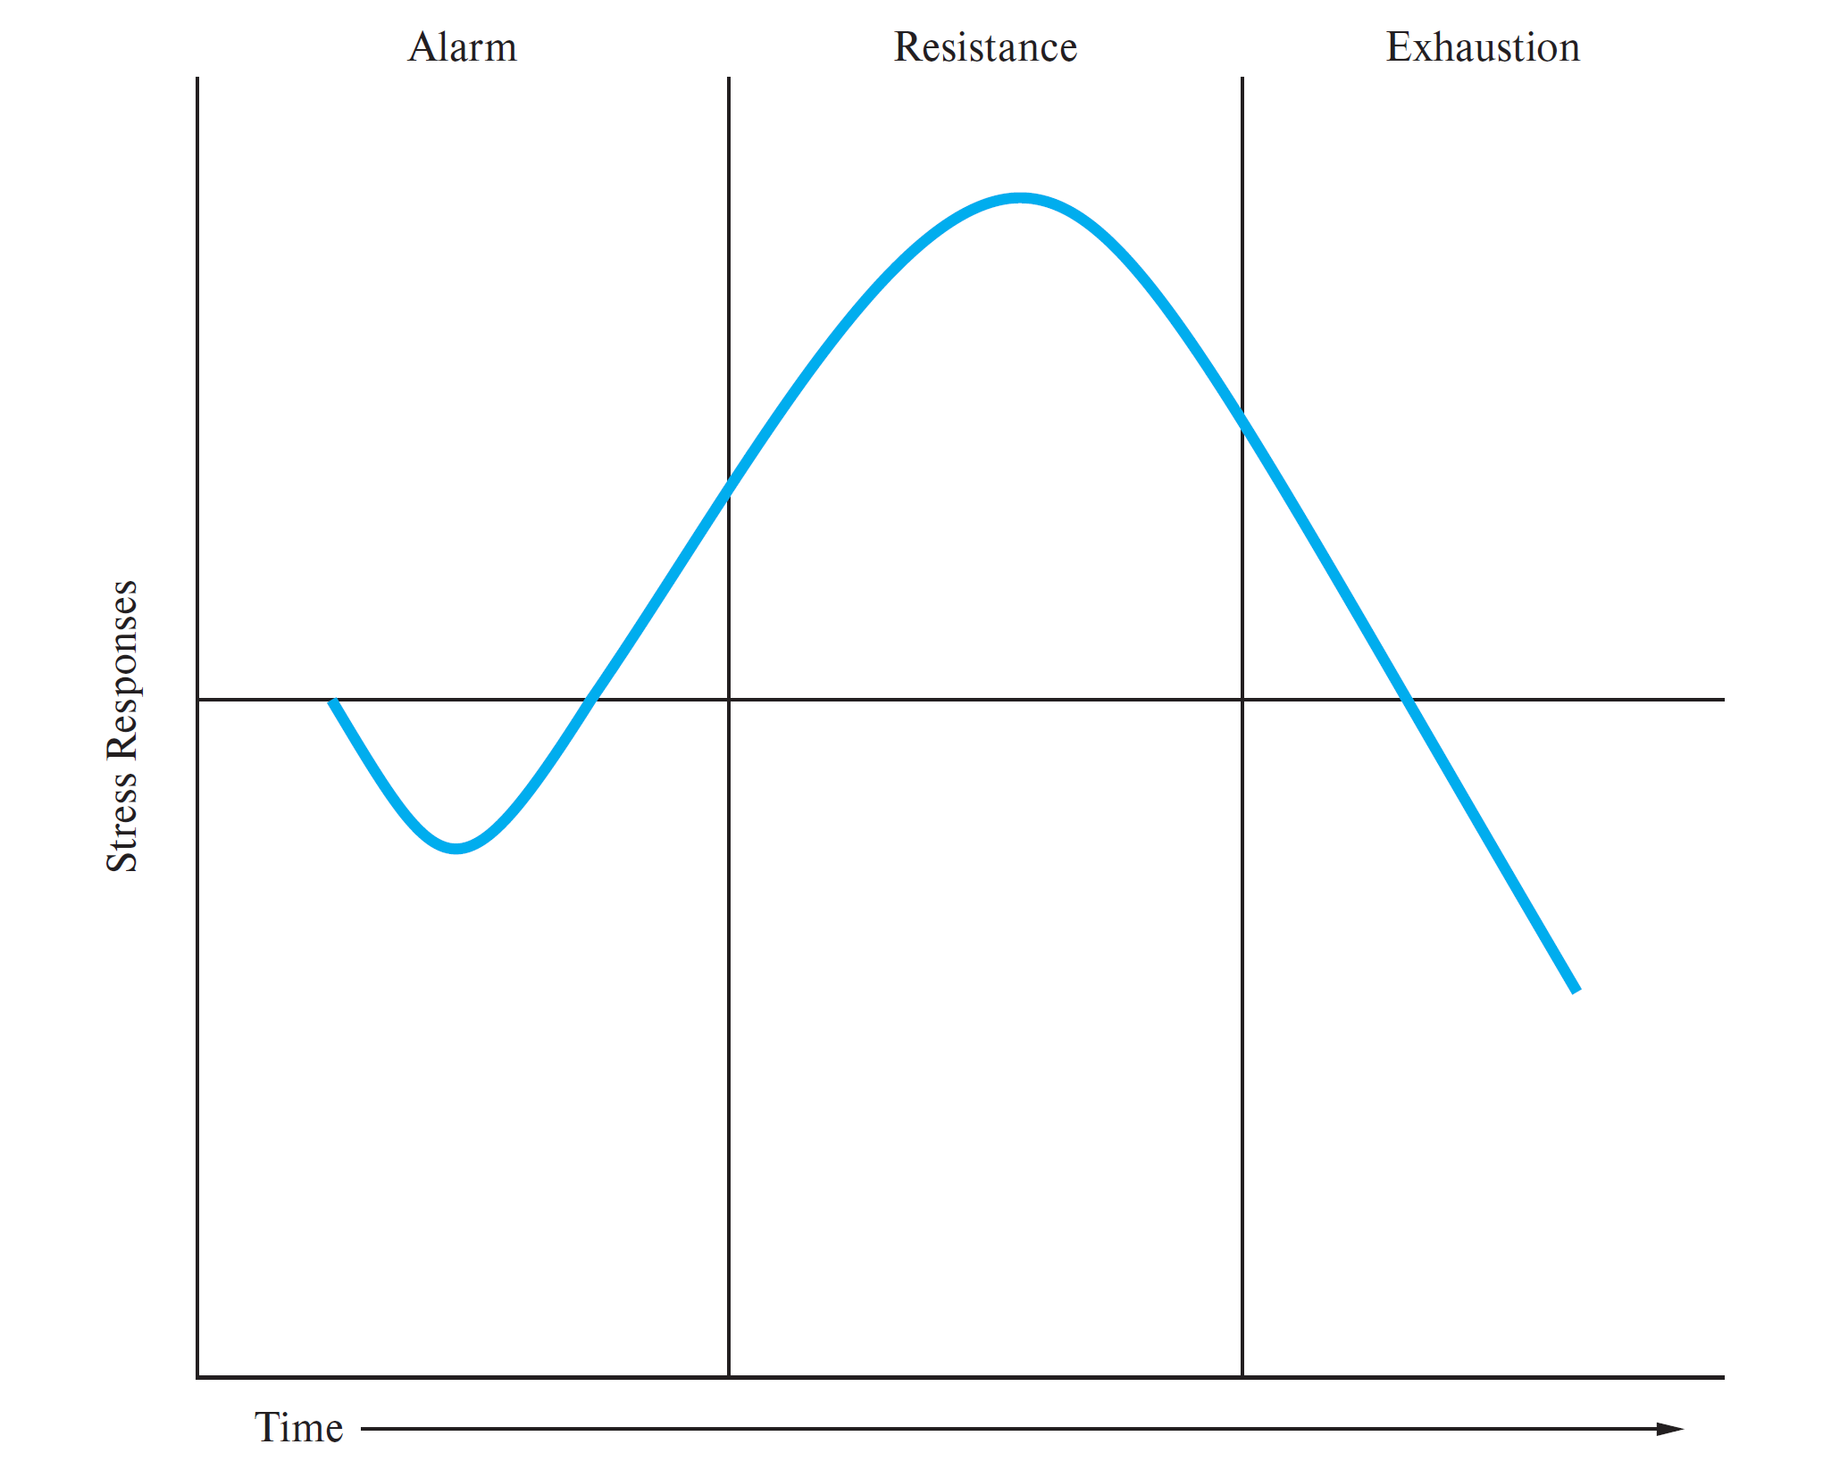
Selye’s General Adaptation Syndrome
Believed that all stress responses followed same pattern of alarm, resistance, exhaustion
Critiques:
Minimal psychological role
Not all stressors produce the same response, nor do all people
Doesn’t address accumulating damage aspect well
Focuses on stress as an outcome, ignoring pre-event stress, or post-event deliberations
Notes:
Doesn’t address accumulating damage aspect well: is it the exhaustion of physiological resources or their chronic activation that is causing stress?

Slide 7
So, what is happening during a stress response?

Slide 8
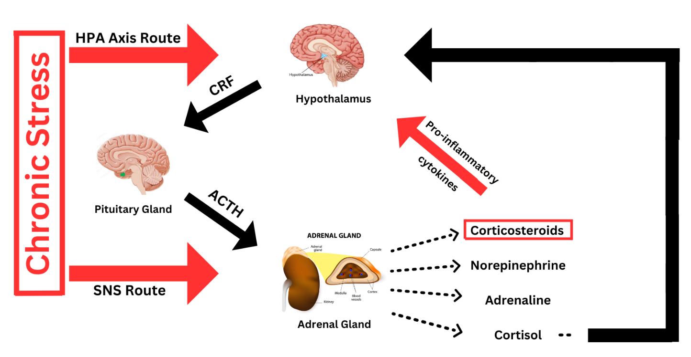
The Physiology of Stress
Step 1: Hypothalamus releases CRF at a higher-than-usual rate
Note: CRF = corticotropin-releasing factor
Notes:
When a person undergoes stress for an extended period of time, the floodgates in the hypothalamus open, and a hormone known as the corticotropin-releasing factor (CRF) is produced at higher-than usual rates (Dai et al., 2020). CRF then travels through the blood to the pituitary gland, where the adrenocorticotropic hormone (ACTH) is released into the blood stream. ACTH travels to the adrenal cortex. This pathway is known as the hypothalamus-pituitary-adrenal (HPA) axis. While this axis is being almost constantly activated, the adrenal gland is also being stimulated by the sympathetic nervous system (SNS), as the body tries to induce a fight-or-flight response to escape the stress it is experiencing. When the adrenal gland is stimulated, it releases a variety of hormones, including corticosteroids, norepinephrine, adrenaline, and cortisol. In a healthy system, cortisol feeds back to glucocorticoid receptors in the hypothalamus, stopping the release of CRF. Research has found that in situations of chronic stress, the glucocorticoid receptors become desensitized to cortisol, so the hypothalamus continues to release CRF (Tausk, 2023). At the same time, the corticosteroids that are being mass-produced as a result of chronic stress alter the production of cytokines. Reiche et al. (2004) stated that when over-produced during chronic stress, corticosteroids can alter the production of pro-inflammatory cytokines. Tausk (2023) reported that these pro-inflammatory cytokines released into the bloodstream can pass through the blood-brain barrier and activate the hypothalamus, further perpetuating the cycle through the HPA axis. This process is illustrated in Figure 2. Being stuck in this cycle can diminish the function of the prefrontal cortex and hippocampus, and lead to a mass production of stress hormones (Dai et al., 2020).

Slide 9
The Physiology of Stress
Step 2: Pituitary gland is hit with CRF, triggering it to release ACTH
Note: ACTH = adrenocorticotropic hormone
Notes:
When a person undergoes stress for an extended period of time, the floodgates in the hypothalamus open, and a hormone known as the corticotropin-releasing factor (CRF) is produced at higher-than usual rates (Dai et al., 2020). CRF then travels through the blood to the pituitary gland, where the adrenocorticotropic hormone (ACTH) is released into the blood stream. ACTH travels to the adrenal cortex. This pathway is known as the hypothalamus-pituitary-adrenal (HPA) axis. While this axis is being almost constantly activated, the adrenal gland is also being stimulated by the sympathetic nervous system (SNS), as the body tries to induce a fight-or-flight response to escape the stress it is experiencing. When the adrenal gland is stimulated, it releases a variety of hormones, including corticosteroids, norepinephrine, adrenaline, and cortisol. In a healthy system, cortisol feeds back to glucocorticoid receptors in the hypothalamus, stopping the release of CRF. Research has found that in situations of chronic stress, the glucocorticoid receptors become desensitized to cortisol, so the hypothalamus continues to release CRF (Tausk, 2023). At the same time, the corticosteroids that are being mass-produced as a result of chronic stress alter the production of cytokines. Reiche et al. (2004) stated that when over-produced during chronic stress, corticosteroids can alter the production of pro-inflammatory cytokines. Tausk (2023) reported that these pro-inflammatory cytokines released into the bloodstream can pass through the blood-brain barrier and activate the hypothalamus, further perpetuating the cycle through the HPA axis. This process is illustrated in Figure 2. Being stuck in this cycle can diminish the function of the prefrontal cortex and hippocampus, and lead to a mass production of stress hormones (Dai et al., 2020).

Slide 10
The Physiology of Stress
Step 3: Adrenal gland is triggered by both the HPA axis and the SNS, at the same time
Note: HPA axis = hypothalamic-pituitary-adrenal axis; SNS = sympathetic nervous system
Notes:
When a person undergoes stress for an extended period of time, the floodgates in the hypothalamus open, and a hormone known as the corticotropin-releasing factor (CRF) is produced at higher-than usual rates (Dai et al., 2020). CRF then travels through the blood to the pituitary gland, where the adrenocorticotropic hormone (ACTH) is released into the blood stream. ACTH travels to the adrenal cortex. This pathway is known as the hypothalamus-pituitary-adrenal (HPA) axis. While this axis is being almost constantly activated, the adrenal gland is also being stimulated by the sympathetic nervous system (SNS), as the body tries to induce a fight-or-flight response to escape the stress it is experiencing. When the adrenal gland is stimulated, it releases a variety of hormones, including corticosteroids, norepinephrine, adrenaline, and cortisol. In a healthy system, cortisol feeds back to glucocorticoid receptors in the hypothalamus, stopping the release of CRF. Research has found that in situations of chronic stress, the glucocorticoid receptors become desensitized to cortisol, so the hypothalamus continues to release CRF (Tausk, 2023). At the same time, the corticosteroids that are being mass-produced as a result of chronic stress alter the production of cytokines. Reiche et al. (2004) stated that when over-produced during chronic stress, corticosteroids can alter the production of pro-inflammatory cytokines. Tausk (2023) reported that these pro-inflammatory cytokines released into the bloodstream can pass through the blood-brain barrier and activate the hypothalamus, further perpetuating the cycle through the HPA axis. This process is illustrated in Figure 2. Being stuck in this cycle can diminish the function of the prefrontal cortex and hippocampus, and lead to a mass production of stress hormones (Dai et al., 2020).

Slide 11
The Physiology of Stress
Step 4: Adrenal gland releases a bunch of hormones
Notes:
When a person undergoes stress for an extended period of time, the floodgates in the hypothalamus open, and a hormone known as the corticotropin-releasing factor (CRF) is produced at higher-than usual rates (Dai et al., 2020). CRF then travels through the blood to the pituitary gland, where the adrenocorticotropic hormone (ACTH) is released into the blood stream. ACTH travels to the adrenal cortex. This pathway is known as the hypothalamus-pituitary-adrenal (HPA) axis. While this axis is being almost constantly activated, the adrenal gland is also being stimulated by the sympathetic nervous system (SNS), as the body tries to induce a fight-or-flight response to escape the stress it is experiencing. When the adrenal gland is stimulated, it releases a variety of hormones, including corticosteroids, norepinephrine, adrenaline, and cortisol. In a healthy system, cortisol feeds back to glucocorticoid receptors in the hypothalamus, stopping the release of CRF. Research has found that in situations of chronic stress, the glucocorticoid receptors become desensitized to cortisol, so the hypothalamus continues to release CRF (Tausk, 2023). At the same time, the corticosteroids that are being mass-produced as a result of chronic stress alter the production of cytokines. Reiche et al. (2004) stated that when over-produced during chronic stress, corticosteroids can alter the production of pro-inflammatory cytokines. Tausk (2023) reported that these pro-inflammatory cytokines released into the bloodstream can pass through the blood-brain barrier and activate the hypothalamus, further perpetuating the cycle through the HPA axis. This process is illustrated in Figure 2. Being stuck in this cycle can diminish the function of the prefrontal cortex and hippocampus, and lead to a mass production of stress hormones (Dai et al., 2020).

Slide 12
The Physiology of Stress
Step 5: In a healthy system, hormones like cortisol tell the hypothalamus to stop CRF production
Notes:
When a person undergoes stress for an extended period of time, the floodgates in the hypothalamus open, and a hormone known as the corticotropin-releasing factor (CRF) is produced at higher-than usual rates (Dai et al., 2020). CRF then travels through the blood to the pituitary gland, where the adrenocorticotropic hormone (ACTH) is released into the blood stream. ACTH travels to the adrenal cortex. This pathway is known as the hypothalamus-pituitary-adrenal (HPA) axis. While this axis is being almost constantly activated, the adrenal gland is also being stimulated by the sympathetic nervous system (SNS), as the body tries to induce a fight-or-flight response to escape the stress it is experiencing. When the adrenal gland is stimulated, it releases a variety of hormones, including corticosteroids, norepinephrine, adrenaline, and cortisol. In a healthy system, cortisol feeds back to glucocorticoid receptors in the hypothalamus, stopping the release of CRF. Research has found that in situations of chronic stress, the glucocorticoid receptors become desensitized to cortisol, so the hypothalamus continues to release CRF (Tausk, 2023). At the same time, the corticosteroids that are being mass-produced as a result of chronic stress alter the production of cytokines. Reiche et al. (2004) stated that when over-produced during chronic stress, corticosteroids can alter the production of pro-inflammatory cytokines. Tausk (2023) reported that these pro-inflammatory cytokines released into the bloodstream can pass through the blood-brain barrier and activate the hypothalamus, further perpetuating the cycle through the HPA axis. This process is illustrated in Figure 2. Being stuck in this cycle can diminish the function of the prefrontal cortex and hippocampus, and lead to a mass production of stress hormones (Dai et al., 2020).

Slide 13
The Physiology of Stress
Step 5b: In a chronically stressed system, hypothalamus desensitizes to cortisol, while corticosteroids mass produce pro-inflammatory cytokines (which can also activate hypothalamus)
Note: cytokines = potent signaling molecules; the immune system’s version of a hormone
Notes:
When a person undergoes stress for an extended period of time, the floodgates in the hypothalamus open, and a hormone known as the corticotropin-releasing factor (CRF) is produced at higher-than usual rates (Dai et al., 2020). CRF then travels through the blood to the pituitary gland, where the adrenocorticotropic hormone (ACTH) is released into the blood stream. ACTH travels to the adrenal cortex. This pathway is known as the hypothalamus-pituitary-adrenal (HPA) axis. While this axis is being almost constantly activated, the adrenal gland is also being stimulated by the sympathetic nervous system (SNS), as the body tries to induce a fight-or-flight response to escape the stress it is experiencing. When the adrenal gland is stimulated, it releases a variety of hormones, including corticosteroids, norepinephrine, adrenaline, and cortisol. In a healthy system, cortisol feeds back to glucocorticoid receptors in the hypothalamus, stopping the release of CRF. Research has found that in situations of chronic stress, the glucocorticoid receptors become desensitized to cortisol, so the hypothalamus continues to release CRF (Tausk, 2023). At the same time, the corticosteroids that are being mass-produced as a result of chronic stress alter the production of cytokines. Reiche et al. (2004) stated that when over-produced during chronic stress, corticosteroids can alter the production of pro-inflammatory cytokines. Tausk (2023) reported that these pro-inflammatory cytokines released into the bloodstream can pass through the blood-brain barrier and activate the hypothalamus, further perpetuating the cycle through the HPA axis. This process is illustrated in Figure 2. Being stuck in this cycle can diminish the function of the prefrontal cortex and hippocampus, and lead to a mass production of stress hormones (Dai et al., 2020).

Slide 14
The Physiology of Stress
Step 6: Hypothalamus never turns “off”, and continually releases CRF into bloodstream
Notes:
When a person undergoes stress for an extended period of time, the floodgates in the hypothalamus open, and a hormone known as the corticotropin-releasing factor (CRF) is produced at higher-than usual rates (Dai et al., 2020). CRF then travels through the blood to the pituitary gland, where the adrenocorticotropic hormone (ACTH) is released into the blood stream. ACTH travels to the adrenal cortex. This pathway is known as the hypothalamus-pituitary-adrenal (HPA) axis. While this axis is being almost constantly activated, the adrenal gland is also being stimulated by the sympathetic nervous system (SNS), as the body tries to induce a fight-or-flight response to escape the stress it is experiencing. When the adrenal gland is stimulated, it releases a variety of hormones, including corticosteroids, norepinephrine, adrenaline, and cortisol. In a healthy system, cortisol feeds back to glucocorticoid receptors in the hypothalamus, stopping the release of CRF. Research has found that in situations of chronic stress, the glucocorticoid receptors become desensitized to cortisol, so the hypothalamus continues to release CRF (Tausk, 2023). At the same time, the corticosteroids that are being mass-produced as a result of chronic stress alter the production of cytokines. Reiche et al. (2004) stated that when over-produced during chronic stress, corticosteroids can alter the production of pro-inflammatory cytokines. Tausk (2023) reported that these pro-inflammatory cytokines released into the bloodstream can pass through the blood-brain barrier and activate the hypothalamus, further perpetuating the cycle through the HPA axis. This process is illustrated in Figure 2. Being stuck in this cycle can diminish the function of the prefrontal cortex and hippocampus, and lead to a mass production of stress hormones (Dai et al., 2020).

Slide 15
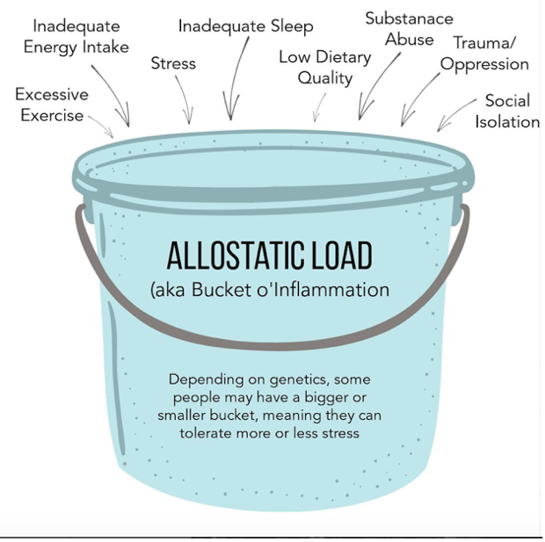
How much stress is too much?
It depends on your capacity to carry stress

Slide 16
Indicators of Allostatic Load
Decreases in cell-mediated immunity.
Inability to shut off cortisol in response to stress.
Lowered heart rate variability.
Elevated epinephrine levels.
A high waist-to-hip ratio, reflecting abdominal fat.
Hippocampal volume, which can decrease with repeated stimulation of the HPA axis.
Problems with memory, an indirect measure of hippocampal functioning.
Elevated blood pressure.

Slide 17
Impact of Chronic Stress
Direct physiological effects.
Elevated lipids.
Elevated blood pressure.
Decreased immunity.
Increased hormonal activity.
Health behavior changes.
Increased smoking and alcohol use.
Decreased nutrition.
Decreased sleep.
Increased drug use.
Poor diet, little exercise.

Slide 18
Impact of Chronic Stress
Psychosocial resources.
Threatened social support.
Reduced optimism.
Threats to self-esteem.
Lower sense of mastery.
Health care.
Decreased adherence to treatment.
Delay in seeking care.
Obscured symptom profile.
Decreased likelihood of seeking care.

Slide 19
Stressors
Negative, uncontrollable, or ambiguous events
Life events (both negative and positive life events)
Daily hassles
Home life/ work life balance
Roles can be protective or cause conflict

Slide 20
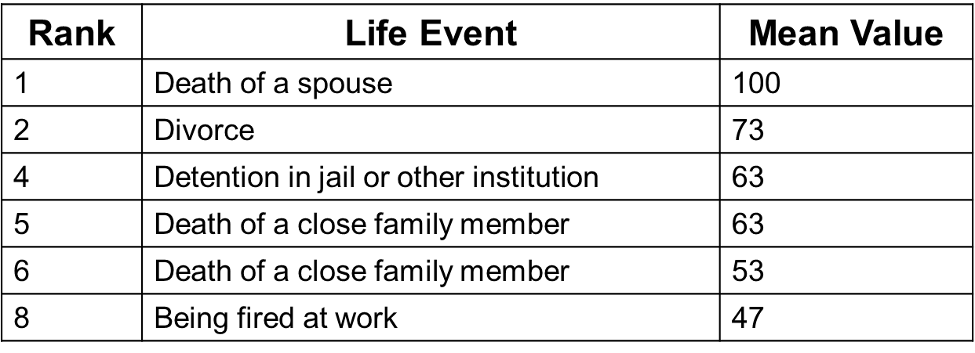
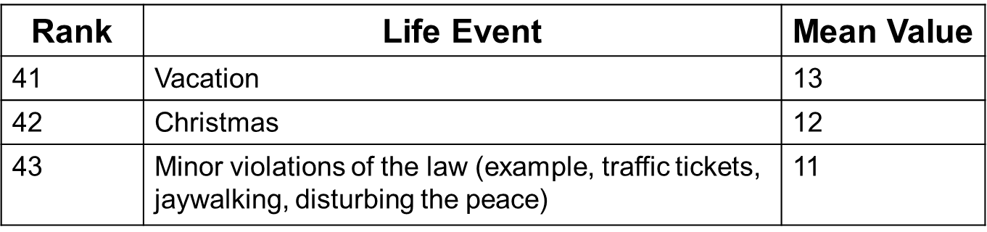
Stressors
Source: Acuna, Laura, and Diana Alejandra González-García. “The Social Readjustment Rating Scale of Holmes and Rahe in Mexico: A Rescaling after 16 Years.” Journal of Psychosomatic Research 11 (January 2012): 213–218.
Notes:
Some items on the life event list are vague.
Individual differences are not considered.
Does not assess whether stressful events have been successfully resolved.
Time between stress and illness does not correlate.

Slide 21
Workplace Stress
Workplace stress is estimated to cost $300 billion a year (in the U.S.)
Multiple factors lead to workplace stress:
Sedentary lifestyle
Overload of expectations
Role conflict
Social dynamics
Unemployment (or risk of unemployment)
Demand-control-support model – High demands and low control are combined with little social support at work.
Linked to risk or coronary artery disease

Slide 22
Stress Adaptation
Stress is known to cause a series of after effects, including (but not limited to):
Shortened attention span
Poor performance on intellectual tasks
Ongoing psychological distress
Physiological arousal
Can we adapt to stress?
Yes, but…
Only to a certain amount of stress
Vulnerable populations (older adults, children, lower SES, etc.) may not be able to

Slide 23
Studying Stress
Ethical concern: should we induce stress in order to study it, when we know it has negative outcomes for health?
Acute stress paradigm
Unplanned presentation
Counting backwards, by difficult sets (e.g., count backwards quickly from 100 by 7s)
Cold pressor
Flu shots/ vaccines
Quasi-experiments
Stress can be assessed with qualitative measures (surveys, interviews, etc.) and quantitative measures (cortisol, blood pressure, heart rate variability, etc.)

Slide 24
Next Time on PSY 440…
Before Next Class:
Work on Behavior Change Paper
In Our Next Class:
Stress Activity

